Slide 1
Effect of EAF slag basicity on steel-slag equilibrium and chromium oxidation
Valentin Nitelet¹, Hoang Tran², Alessandro D'Alfonso³, Jean-Christophe Pierret², Alexandre Mégret¹, Véronique Vitry¹
¹ Metallurgy Department, Faculty of Engineering, UMONS-University of Mons, Belgium
² Center for Research in Metallurgy (CRM), Liège, Belgium
³ APERAM, Charleroi, Belgium
valentin.nitelet@umons.ac.be

Slide 2
Context
Context/EAF Process/Method/Steel-Slag equilibrium/Comparison FactSage/Chromium oxidation/Conclusion
Valentin Nitelet
PhD student at the Faculty of Engineering at the University of Mons in Belgium
Stainless steelmaking
Electric arc furnace (EAF) route
Recycling⁽¹⁾
CO₂ production⁽²⁾
Evolution to increase efficiency and productivity
Better knowledge of the process
Decreasing time
(1) J. Muract, “MAN01052 – Electric Arc Furnace - steeluniversity,” Jul. 2016. [Online]. Available: https://steeluniversity.org/courses/man01052-electric-arc-furnace/
(2) S. Jahanshahi, J. G. Mathieson, M. A. Somerville, N. Haque, T. E. Norgate, A. Deev, Y. Pan, D. Xie, P. Ridgeway, and P. Zulli, “Development of Low-Emission Integrated Steelmaking Process,” Journal of Sustainable Metallurgy, vol. 1, no. 1, pp. 94–114, Mar. 2015. [Online]. Available: https://doi.org/10.1007/s40831-015-0008-6
Numerical model for stainless steel

Slide 3


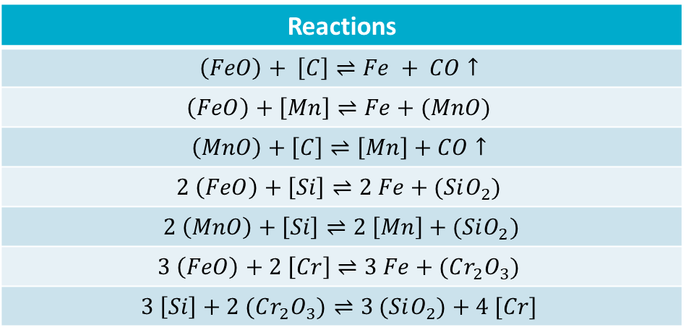
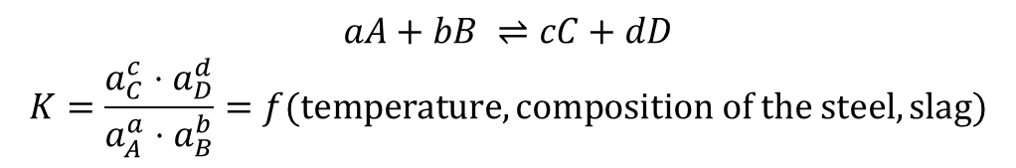
Context
Context/EAF Process/Method/Steel-Slag equilibrium/Comparison FactSage/Chromium oxidation/Conclusion
Adaptation of a model on the EAF process for stainless steel
CRM Model
Thermodynamic considerations
Expression of K for many reactions
Carbon steel
CRM: Center
of Research
in Metallurgy (Be)
Reactions
$$\left(FeO\right)+ \left[C\right]⇌Fe + CO↑$$
$$\left(FeO\right)+\left[Mn\right]⇌Fe+(MnO)$$
$$\left(MnO\right)+\left[C\right]⇌\left[Mn\right]+CO↑$$
$$2 \left(FeO\right)+\left[Si\right]⇌2 Fe+(SiO_{2})$$
$2 \left(MnO\right)+\left[Si\right]⇌2 \left[Mn\right]+(SiO_{2})$
$$3 \left(FeO\right)+2 \left[Cr\right]⇌3 Fe+(Cr_{2}O_{3})$$
$$3 \left[Si\right]+2 (Cr_{2}O_{3})⇌3 (SiO_{2})+4 [Cr]$$
Stainless steel
High concentration (>11wt.% of Cr)
$$aA+bB ⇌cC+dD$$
$$K=\frac{a_{C}^{c}⋅a_{D}^{d}}{a_{A}^{a}⋅a_{B}^{b}}=f(temperature, composition of the steel, slag)$$
New expression of K for the reactions
Calculation Phase Diagram modelling (CalPhaD)
Thermo-Calc

Slide 4
Electric Arc Furnace (EAF) Process⁽¹⁾
Context/EAF Process/Method/Steel-Slag equilibrium/Comparison FactSage/Chromium oxidation/Conclusion
(1) J. Muract, “MAN01052 – Electric Arc Furnace - steeluniversity,” Jul. 2016. [Online]. Available: https://steeluniversity.org/courses/man01052-electric-arc-furnace/
Electrodes
Steel
Roof
Water cooling system
Wall in refractory materials (e.g. MgO for stainless steel)
Furnace
Burners and oxygen injection

Slide 5
Electric Arc Furnace (EAF) Process⁽¹⁾
Context/EAF Process/Method/Steel-Slag equilibrium/Comparison FactSage/Chromium oxidation/Conclusion
(1) J. Muract, “MAN01052 – Electric Arc Furnace - steeluniversity,” Jul. 2016. [Online]. Available: https://steeluniversity.org/courses/man01052-electric-arc-furnace/
To be continued…
Addition of oxide and injection of oxygen and natural gas
Addition of oxide and injection of oxygen and natural gas
Addition of oxide and injection of oxygen
Basket preparation:
2/3 baskets with scraps
Charging of basket 1
Melt down charging 1
Charging of basket 2
Melt down charging 2
Refining
Tapping
Power supply during the process

Slide 6
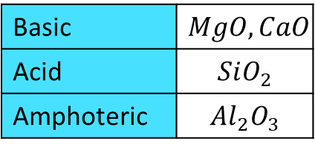
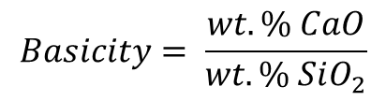
Electric Arc Furnace (EAF) Process⁽¹⁾
Context/EAF Process/Method/Steel-Slag equilibrium/Comparison FactSage/Chromium oxidation/Conclusion
(1) J. Muract, “MAN01052 – Electric Arc Furnace - steeluniversity,” Jul. 2016. [Online]. Available: https://steeluniversity.org/courses/man01052-electric-arc-furnace/
Slag = mix of oxides
To protect the refractory on the wall
To help for refining step
To protect steel thermally
from the outside
Slag
Steel
Important Property of the slag for these purposes
Basic | $$MgO, CaO$$
Acid | $$SiO_{2}$$
Amphoteric | $$Al_{2}O_{3}$$
$$Basicity= \frac{wt. \% CaO}{wt. \% SiO_{2}}$$
Study the influence of slag basicity on equilibrium steel-slag

Slide 7
Method
Context/EAF Process/Method/Steel-Slag equilibrium/Comparison FactSage/Chromium oxidation/Conclusion
System
Stainless Steel
Oxygen
Slag
304 grade
Basicity
Amount of FeO
Steel composition
[wt.%]
0 wt.%
Fe | 71.18
Cr | 18
C | 0.07
Ni | 8
Si | 0.75
Mn | 2
0.1
0.5
1
1.5
2
10 wt.%
20 wt.%

Slide 8
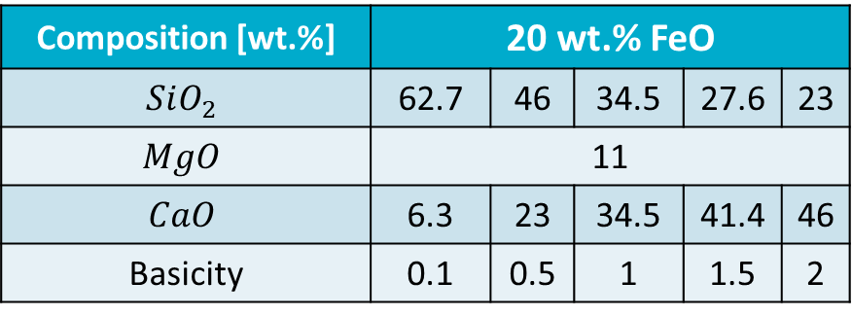
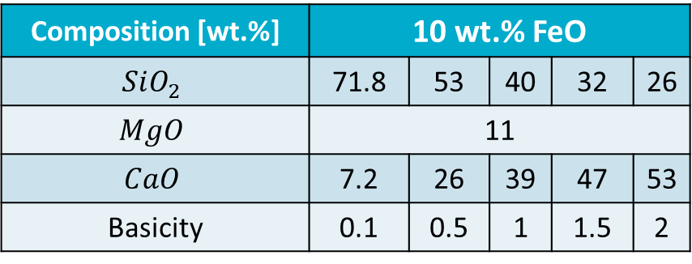
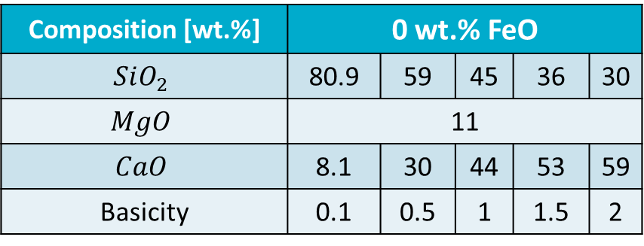
Method
Context/EAF Process/Method/Steel-Slag equilibrium/Comparison FactSage/Chromium oxidation/Conclusion
Composition [wt.%] | 0 wt.% FeO
$$SiO_{2}$$ | 80.9 | 59 | 45 | 36 | 30
$$MgO$$ | 11
$$CaO$$ | 8.1 | 30 | 44 | 53 | 59
Basicity | 0.1 | 0.5 | 1 | 1.5 | 2
Composition [wt.%] | 10 wt.% FeO
$$SiO_{2}$$ | 71.8 | 53 | 40 | 32 | 26
$$MgO$$ | 11
$$CaO$$ | 7.2 | 26 | 39 | 47 | 53
Basicity | 0.1 | 0.5 | 1 | 1.5 | 2
Composition [wt.%] | 20 wt.% FeO
$$SiO_{2}$$ | 62.7 | 46 | 34.5 | 27.6 | 23
$$MgO$$ | 11
$$CaO$$ | 6.3 | 23 | 34.5 | 41.4 | 46
Basicity | 0.1 | 0.5 | 1 | 1.5 | 2

Slide 9
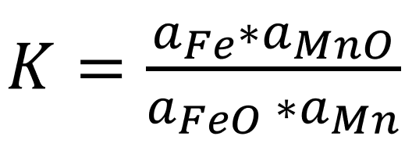
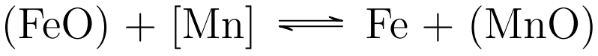
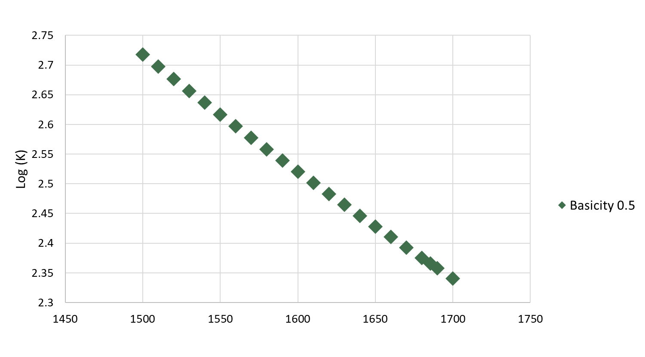
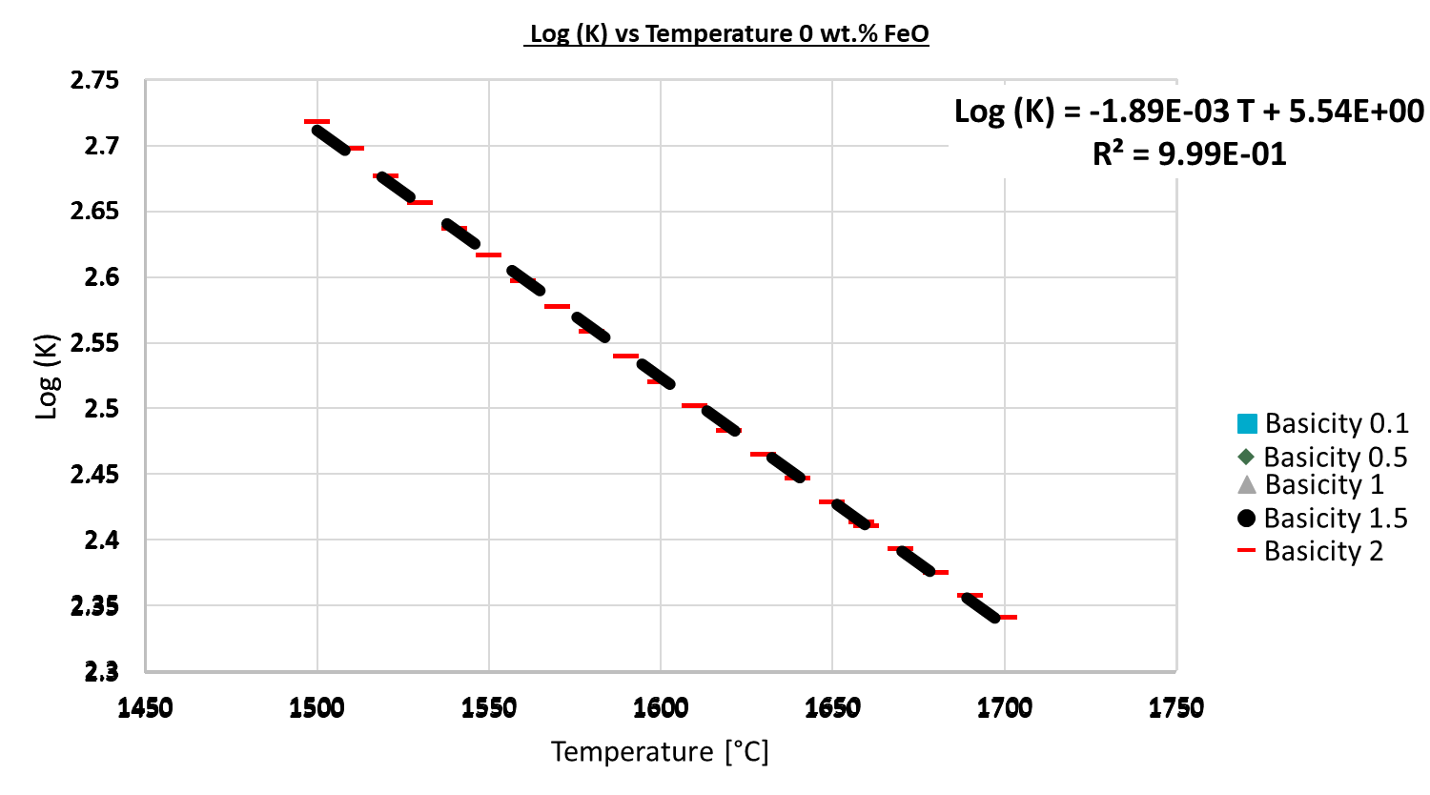
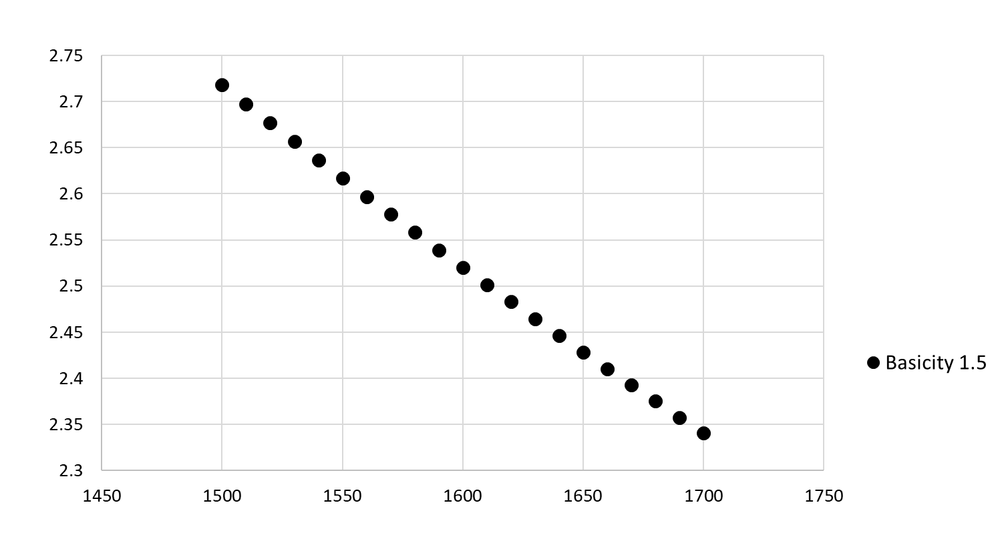
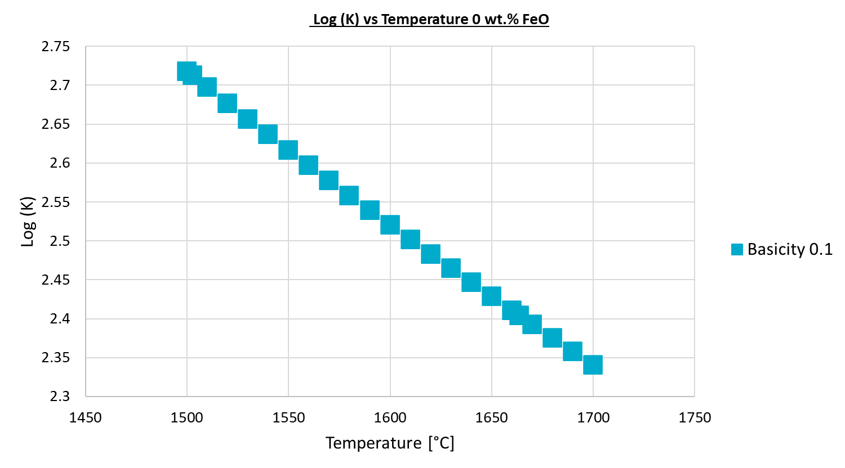
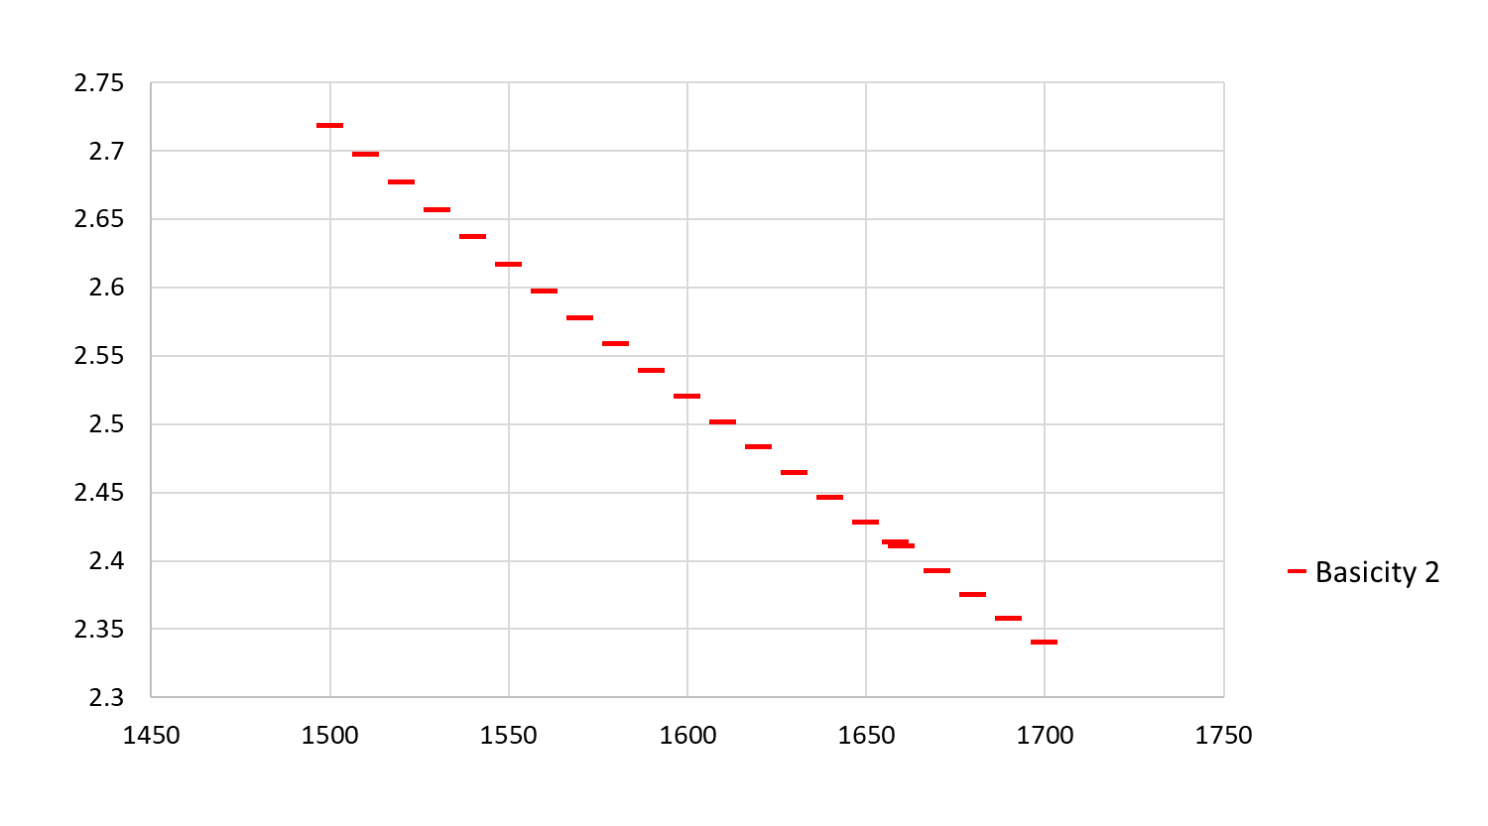
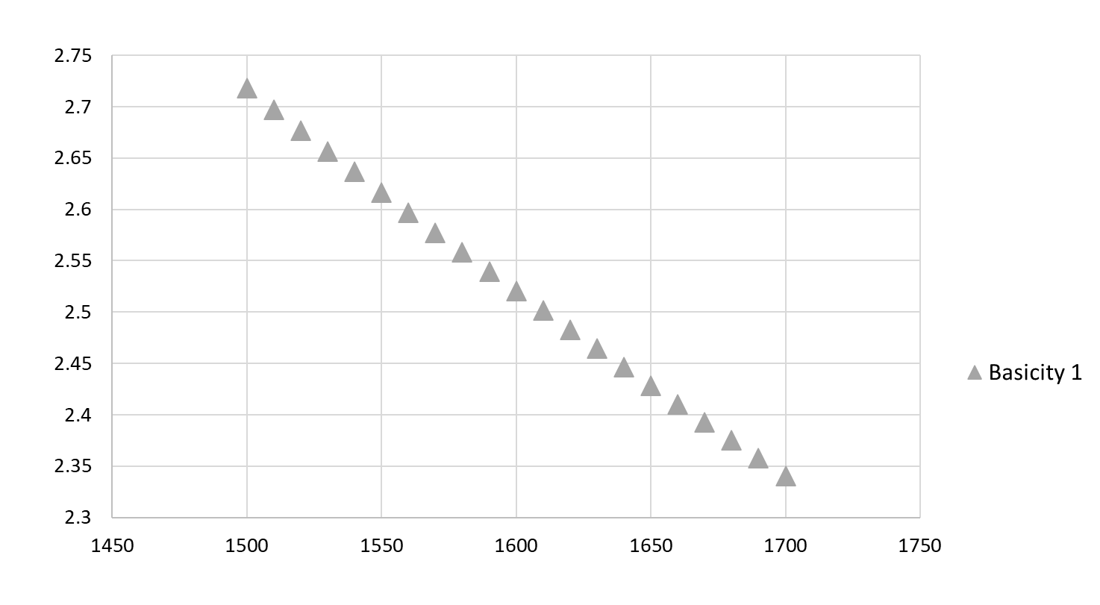
Steel-Slag equilibrium
Context/EAF Process/Method/Steel-Slag equilibrium/Comparison FactSage/Chromium oxidation/Conclusion

Slide 10
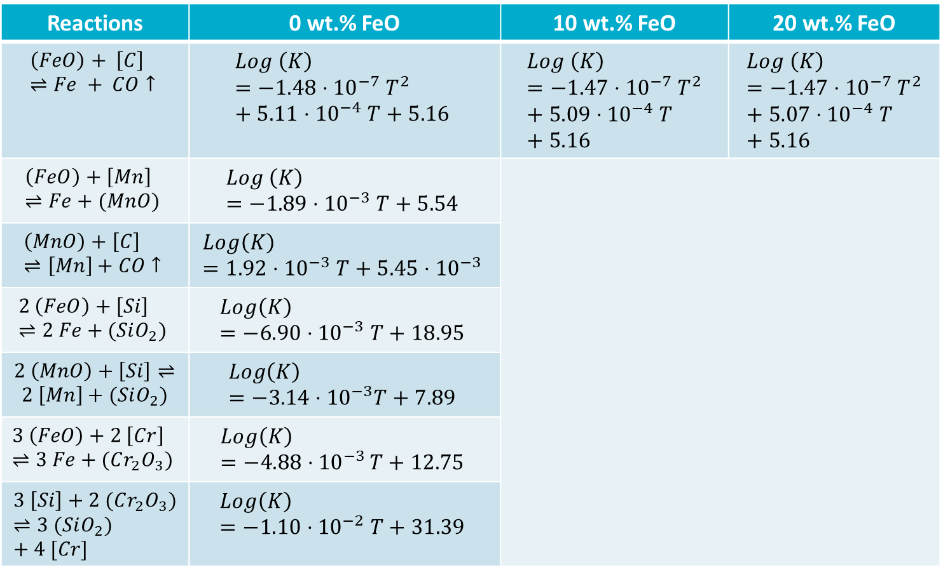
Steel-Slag equilibrium
Context/EAF Process/Method/Steel-Slag equilibrium/Comparison FactSage/Chromium oxidation/Conclusion
Reactions | 0 wt.% FeO | 10 wt.% FeO | 20 wt.% FeO
$$\left(FeO\right)+ \left[C\right]⇌Fe + CO↑$$ | $$Log \left(K\right)=−{1.48⋅10}^{−7} T^{2}+{5.11⋅10}^{−4} T+5.16$$ | $$Log \left(K\right)=−{1.47⋅10}^{−7} T^{2}+{5.09⋅10}^{−4} T+5.16$$ | $$Log \left(K\right)=−{1.47⋅10}^{−7} T^{2}+{5.07⋅10}^{−4} T+5.16$$
$$\left(FeO\right)+\left[Mn\right]⇌Fe+(MnO)$$ | $$Log \left(K\right)=−1.89⋅{10}^{−3} T+5.54$$
$$\left(MnO\right)+\left[C\right]⇌\left[Mn\right]+CO↑$$ | $$Log\left(K\right)=1.92⋅{10}^{−3} T+5.45⋅{10}^{−3}$$
$$2 \left(FeO\right)+\left[Si\right]⇌2 Fe+(SiO_{2})$$ | $$Log\left(K\right)=−6.90⋅{10}^{−3} T+18.95$$
$2 \left(MnO\right)+\left[Si\right]⇌2 \left[Mn\right]+(SiO_{2})$ | $$Log\left(K\right)=−3.14⋅{10}^{−3}T+7.89$$
$$3 \left(FeO\right)+2 \left[Cr\right]⇌3 Fe+(Cr_{2}O_{3})$$ | $$Log\left(K\right)=−4.88⋅{10}^{−3 }T+12.75$$
$$3 \left[Si\right]+2 (Cr_{2}O_{3})⇌3 (SiO_{2})+4 [Cr]$$ | $$Log\left(K\right)=−{1.10⋅10}^{−2} T+31.39$$
Is the difference significant?
More steps at the end
More steps at the beginning
The trend line depends on the dataset
The step of Thermo-Calc
Temperature step can change during the simulation
Not significant

Slide 11
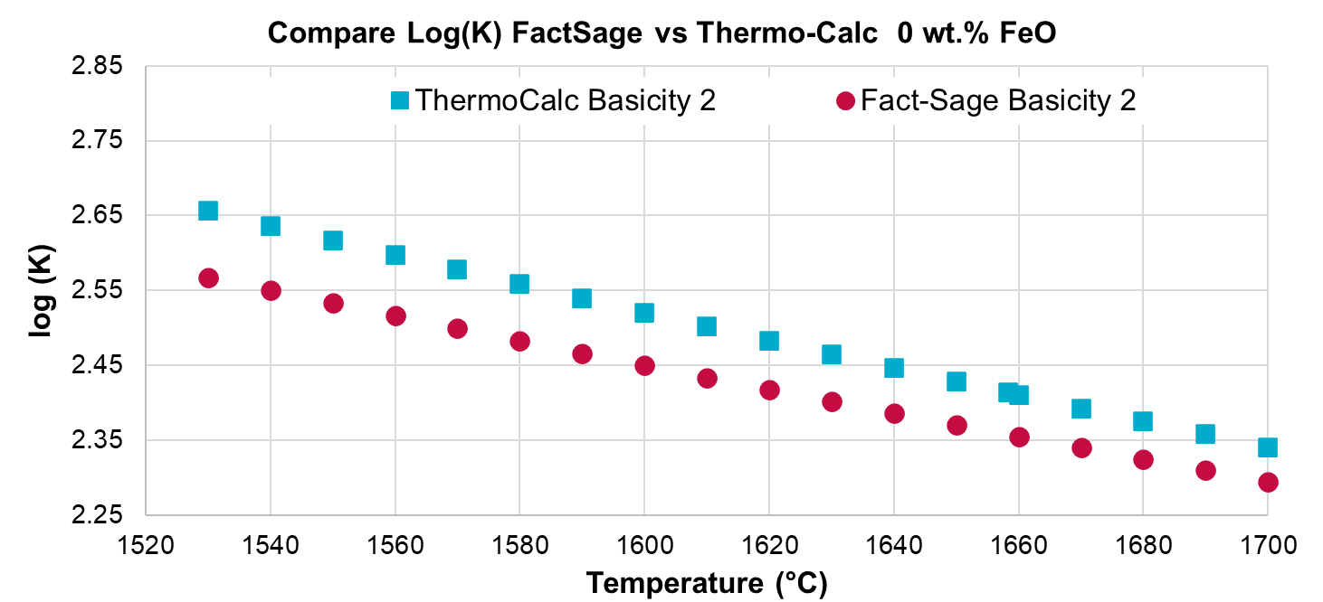
Comparison with FactSage
Context/EAF Process/Method/Steel-Slag equilibrium/Comparison FactSage/Chromium oxidation/Conclusion
Thermo-Calc Basicity 2
FactSage Basicity 2
Relatively similar
Where does the difference come from?
Database?
Research to determine whether the difference is significant

Slide 12



Conclusion on the expressions
Context/EAF Process/Method/Steel-Slag equilibrium/Comparison FactSage/Chromium oxidation/Conclusion
We have the expressions of Log(K) as a function of the temperature
What is the next step?
Let’s talk about another aspect of stainless steel
To wait for the industrial trials
Nothing else?

Slide 13
Basicity effect on the activity of chromium and chromium oxide
Context/EAF Process/Method/Steel-Slag equilibrium/Comparison/Chromium oxidation/Conclusion
Stainless steel
Steel with at least 11 wt.% of chromium
Unwanted
Injection of oxygen at the EAF process
Oxidation of chromium before oxidation of carbon⁽¹⁾
Chromium oxide goes in the slag
To reduce the chromium oxide from the slag to the Stainless Steel⁽²⁾
=
Recovery step
FeSi
Ma, Z. and Janke, D. (2003), Thermodynamic Assessment to Chromium Oxidation in the Production of Stainless Steel. steel research international, 74: 99-103. https://doi.org/10.1002/srin.200300167
Guo, M., Durinck, D., Jones, P.T., Heylen, G., Hendrickx, R., Baeten, R., Blanpain, B. and Wollants, P. (2007), EAF Stainless Steel Refining - Part I: Observational Study on Chromium Recovery in an Eccentric Bottom Tapping Furnace and a Spout Tapping Furnace. steel research international, 78: 117-124. https://doi.org/10.1002/srin.200705868
We want to decrease the loss of chromium and increase the reduction of chromium oxide

Slide 14
Basicity effect on the activity of chromium and chromium oxide
Context/EAF Process/Method/Steel-Slag equilibrium/Comparison FactSage/Chromium oxidation/Conclusion
The condition are desired to decrease the chromium oxidation
To decrease the activity of chromium⁽¹⁾
Basicity
The conditions are desired to increase the chromium oxide reduction
To increase the chromium oxide activity⁽²⁾
The choice of the reducing agent⁽²⁾
Ma, Z. and Janke, D. (2003), Thermodynamic Assessment to Chromium Oxidation in the Production of Stainless Steel. steel research international, 74: 99-103. https://doi.org/10.1002/srin.200300167
Guo, M., Durinck, D., Jones, P.T., Heylen, G., Hendrickx, R., Baeten, R., Blanpain, B. and Wollants, P. (2007), EAF Stainless Steel Refining - Part I: Observational Study on Chromium Recovery in an Eccentric Bottom Tapping Furnace and a Spout Tapping Furnace. steel research international, 78: 117-124. https://doi.org/10.1002/srin.200705868

Slide 15
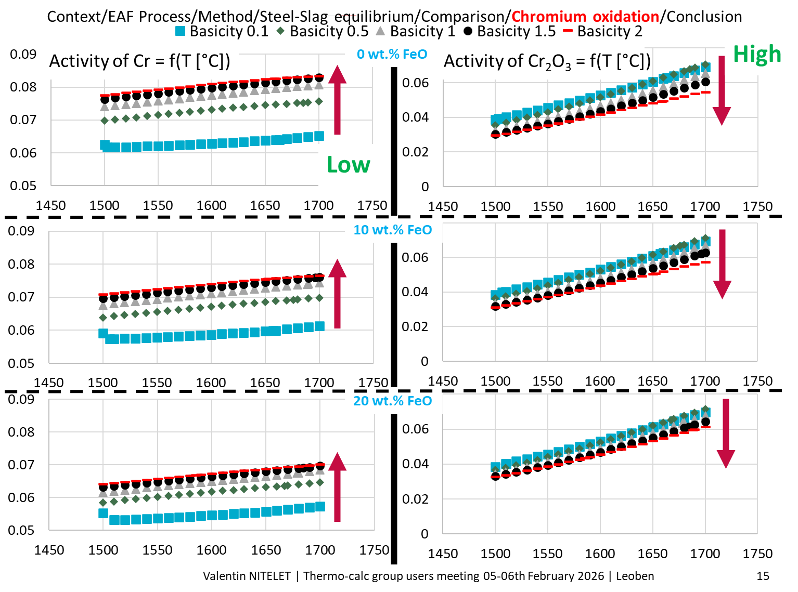

Slide 16

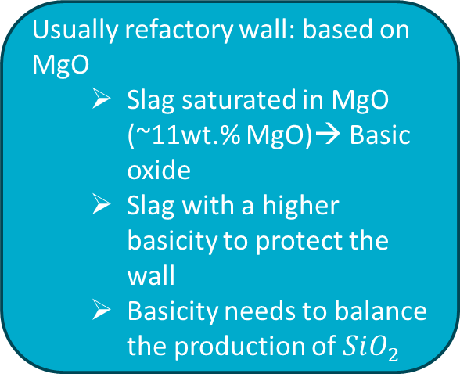
Basicity effect on the activity of chromium and chromium oxide
Context/EAF Process/Method/Steel-Slag equilibrium/Comparison FactSage/Chromium oxidation/Conclusion
To decrease the activity of chromium
To increase the activity of chromium oxide
Purposes of the slag
Protect the refractory on the wall
Help for refining step
Protect steel thermally from outside
BASICITY
Usually refactory wall: based on MgO
  Slag saturated in MgO (~11wt.% MgO)→ Basic oxide
  Slag with a higher basicity to protect the wall
  Basicity needs to balance the production of $SiO_{2}$
BASICITY
BASICITY around ~1-1.5

Slide 17

Conclusion
Context/EAF Process/Method/Steel-Slag equilibrium/Comparison FactSage/Chromium oxidation/Conclusion
The influence of slag basicity on equilibrium steel-slag
Basicity affects elements and oxide activities
Very low effect of the slag basicity on the equilibrium constant
To consider other elements that could affect the equilibrium constant
To make the industrial trials to verify the expressions and validate the model
Thank you
for your attention
Basicity effect on the activity of chromium and chromium oxide
Basicity has an effect on chromium and chromium oxide activities
Opposite effect → We need to optimise the condition
To study other reducing agents instead of FeSi
I want to thank the Walloon region for the funding
(Convention: 8948), my co-supervisor, CRM, APERAM and Nicholas from Thermo-Calc

